Slide 1

Indian General elections’14 Analysis in R
Probability and its Applications

Slide 2
ABSTRACT
R is a programming language and software environment for statistical computing and graphics. The R language is widely used among statisticians and data miners for developing statistical software and data analysis. Polls, surveys of data miners, and studies of scholarly literature databases' provides a wide variety of statistical (linear and nonlinear modelling, classical statistical tests, time-series analysis, classification, clustering, …) and graphical techniques, and is highly extensible.
Election Process involves a wide study of factors, how each demographic features in Indian scenario are effecting elections and many more…So as we go on dealing with different aspects we will be in need of certain measure which will best fits to make a conclusion. It may be religious factor , Development agenda , caste etc.. To make a good conclusion from data we need a proper Statistical analysis to make a conclusion. So we make use of good Statistical tool like R to analyse data with our statistical formula and make a comment on it.

Slide 3
Miscellaneous Statistics
Charts of Male/Female Vote Percentage & Number of Electors/PC for General Elections (1951 to 2014)
Political Parties - Organisation Election, Contribution Reports, Expense Reports Analysis
Votes Polled in favour of Winner as Percentage of Electors/Voters (each State wise)
Number of Polling Stations (State wise)
Electoral Rolls Data ( Gender )
Turnout Lok Sabha Elections - 1952-2014
Lok Sabha Election Expenditure ( Party Wise )
Factors analysis in a constituency of General Elections ( Lok sabha ) in a state(like Tamil Nadu )
Exit Polls analysis
Extending data from Small sample of Poll to large Sample of Poll
Various Tests of Statistics

Slide 4
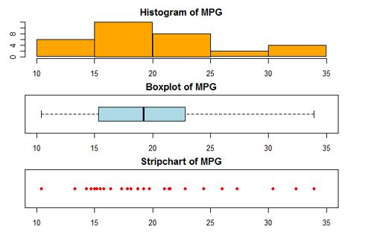
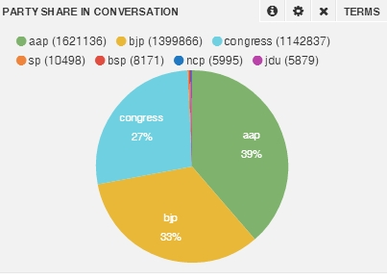
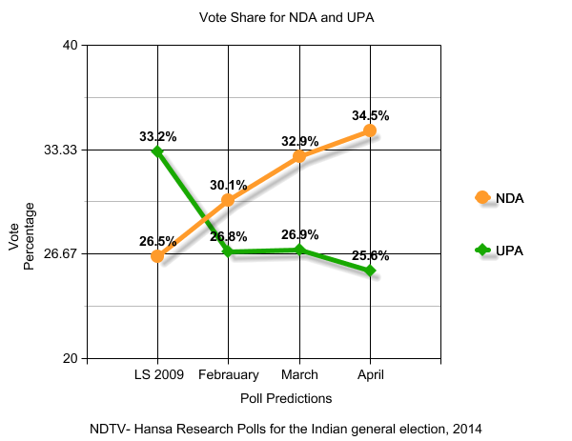
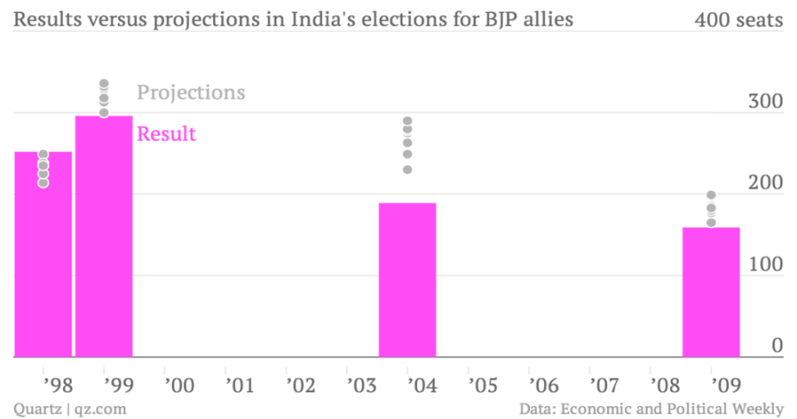
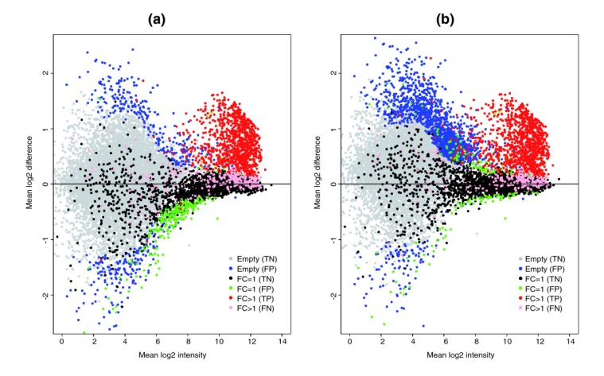
VARIOUS PLOTS IN R

Slide 5
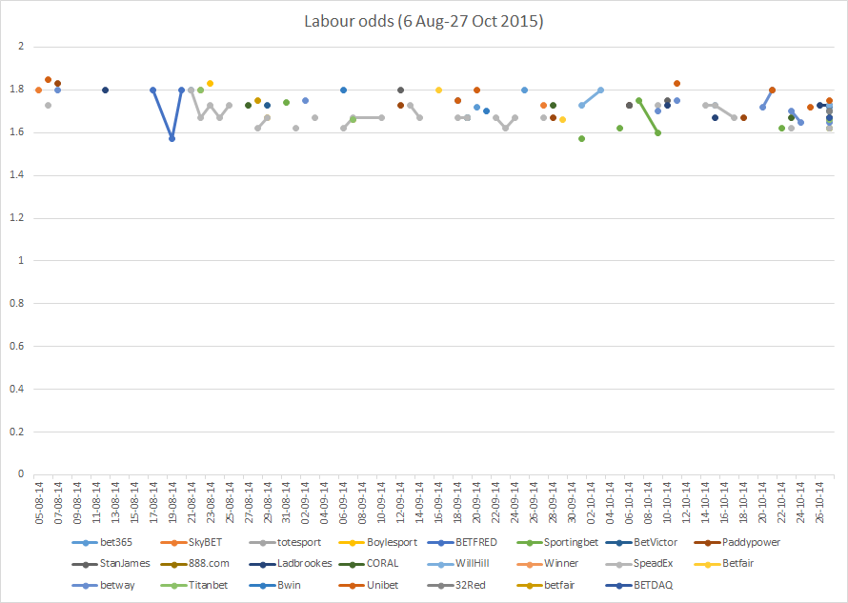
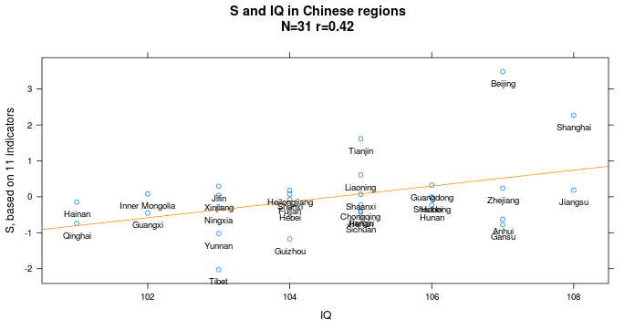
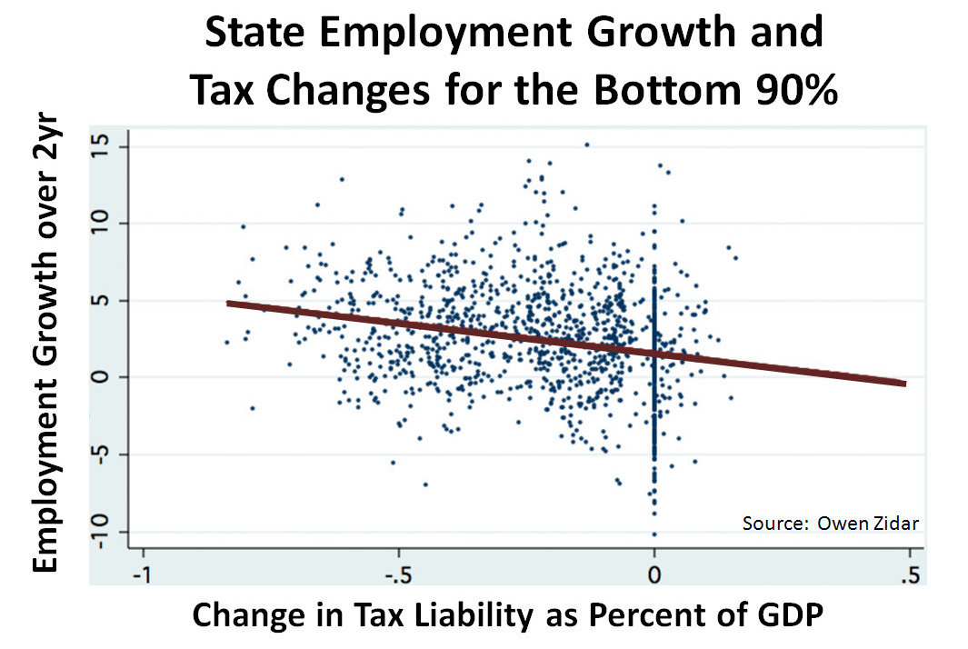
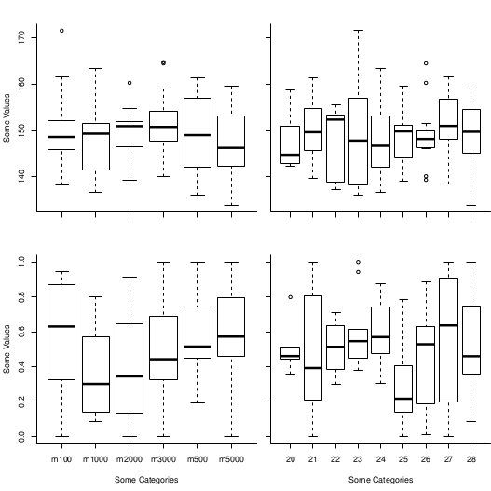
VARIOUS PLOTS IN R

Slide 6
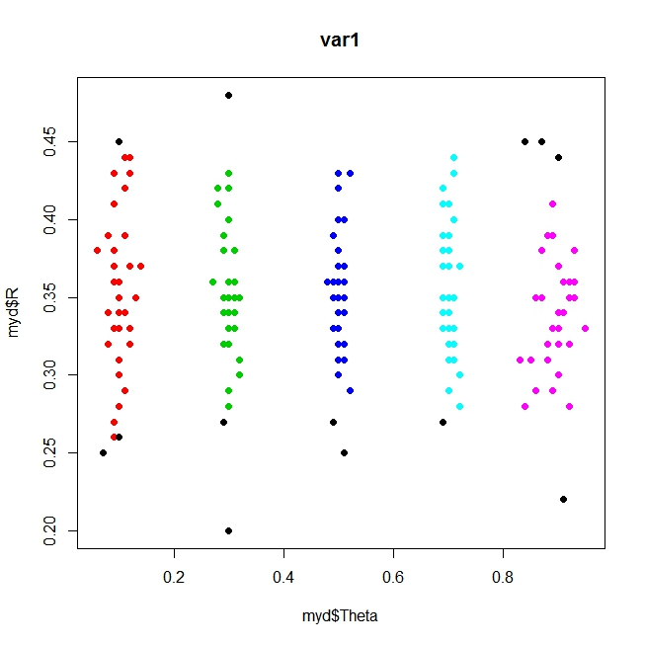
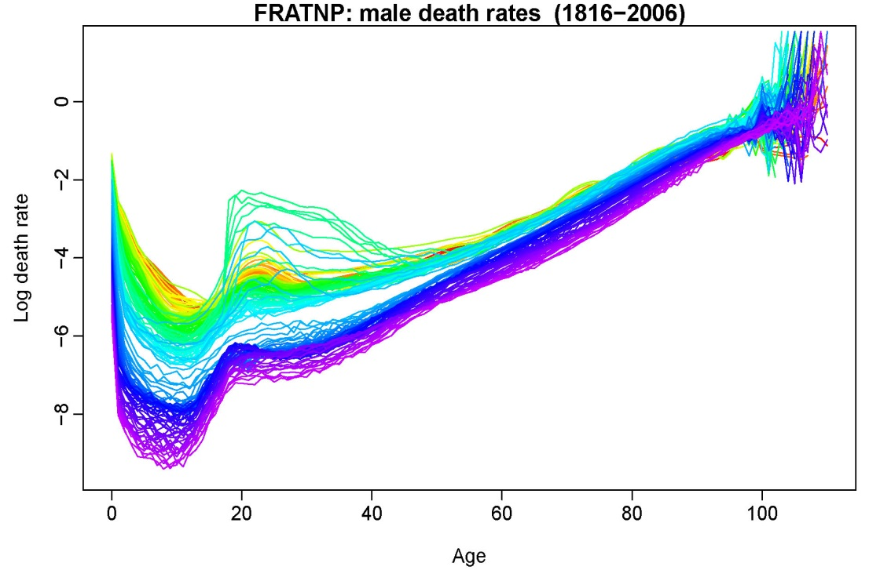
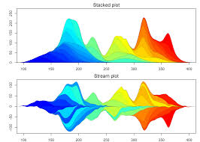
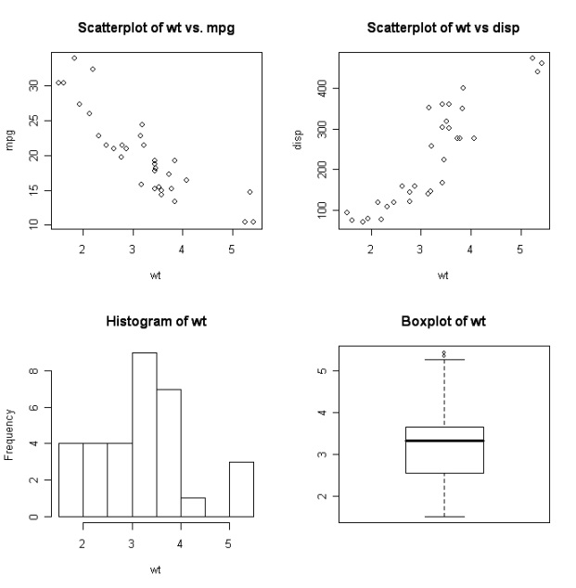
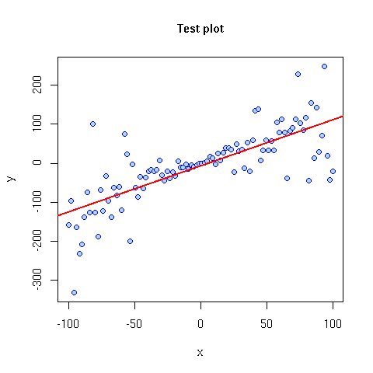
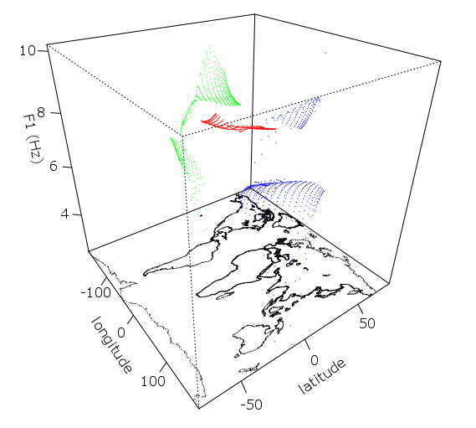
VARIOUS PLOTS IN R

Slide 7
WHAT WE CAN ANALYSE..?
If we have a certain data in ‘.ODT’ format or in excel file. We can generate moment generating function , characteristic function and joint distribution function and analyse it in R.
If we give data .We can code in R to get general summary like mean , variance , Highest and lowest values etc.. From that we can generate required function accordingly.
Further we can get general distribution curves like Gamma , Binomial ,Poisson etc.. From Data or Compare with general distributions like Normal etc..

Slide 8
FURTHUR Direct Analysis in Statistics
Testing of hypothesis
T-test
F-test
Chi-square test
Reliability

Slide 9

Marla Akhil reddy ( 13bce1078 ) jagmohan Singh ( 13bce1056 )

